Slide 1
User Focus Personas
Lecture 10

Slide 2
Design for a Single User
If you try to please everyone, you will please no one
If you try to build a car that satisfy the following three sets of people
Mothers with young children
Carpenters
Young executives

Slide 3

Design for a Single User
Then you will get something like this!!!!

Slide 4



Design for a Single User
What is the solution?
You need different cars for the three different sets of people described in the previous slide

Slide 5
Design for a Single User
Unlike cars, in terms of software the same product can behave as three different ones
But in that case you have to ensure it doesn’t over complicate things

Slide 6
Design for a Single User
The broader a target you aim for, the more certainty you have of missing the bull's-eye.
If you want to achieve a product-satisfaction level of 50%, you cannot do it by making a large population 50% happy with your product
You can only accomplish it by singling out 50% of the people and striving to make them 100% happy
That’s what Persona’s help us do. ..Focus on who we are designing for

Slide 7

What are Personas?
Personas are model users that we create based on our research.
Each Persona represents a usage pattern
A narrative description of a synthetic user that represents an important usage pattern.
Determined by clustering user responses
We create a character and put in him/her qualities and characteristics we have observed in real users having a specific usage pattern.
Persona’s are like your north star guiding your design decisions throughout the project

Slide 8
Creating Personas
After you have done research about users and their goals and tasks
You need to translate this into design
After research you will have pages and pages of observations.
To use these observations you can use the powerful concept of models
We are creating model users based on our research
We will divide our qualitative and quantitative data into Persona groups, based on usage patterns of our main target users.

Slide 9
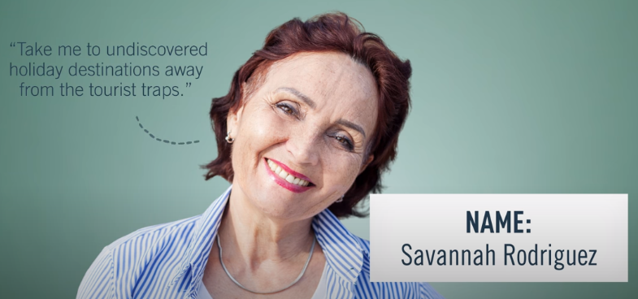
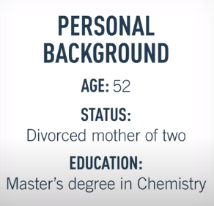

Creating Personas
First create a header, this includes a name, picture and a quote.
Add a demographic profile based on your research
Personal Background
Age
Gender
Family
Education
Professional Background
Occupation
Income level
Work experience

Slide 10
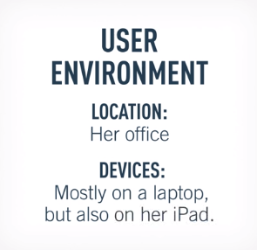
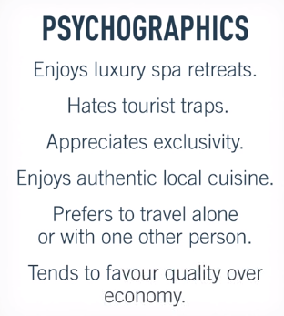
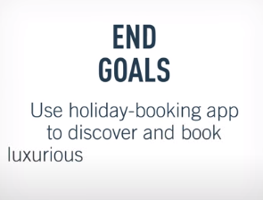
Creating Personas
User Environment
It can include physical, social and technological context
Information includes what devices the user uses, where do they spend most of their time, office or home? How often do they collaborate with others?
Psychographic Information
(this is where we link details)
Attitudes
Motivations
Pain points
Interests
End Goal
The motivating factor, linking Persona with
The product
Notes:
Psychographics : study of peoples characteristics, attitudes etc

Slide 11
Why Personas
Personas help you remember
that you are not designing for everyone
You are not designing for some vague concept of User
It helps you focus on the specific people with specific needs

Slide 12
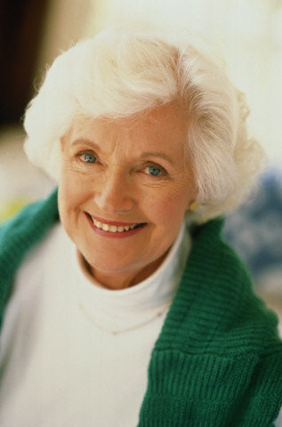
Grace
(62/ female/ widowed/ Little Rock, AR.)
“I like playing my favorite games online, but if I can play with friends, well that’s even better!”
Personal Background: Her husband has passed on. She has two grown kids, both of whom live far away. She misses the kids, but has a fairly large circle of friends that she spends time with.
Technical Proficiency Profile: Limited. Can use her browser and her email. MS Word confuses her, and she doesn’t like using it. Doesn’t know what an OS is. Tends to click yes if the browser prompts her to do anything, and will click wildly until things work.
History with Shockwave and/or AtomFilms: Plays crossword puzzles daily and saves them. Plays card games, Photo Jam, but is offended by South Park cartoons
Shockwave’s opportunity: If Grace can be convinced to participate in community activities, she will become a loyal user of the site. She needs to be sheltered from the sick and twisted content, however.

Slide 13
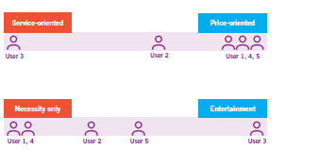

Slide 14


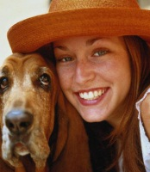
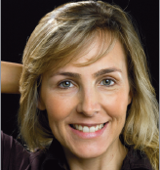
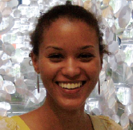
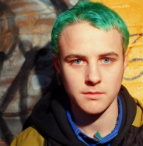
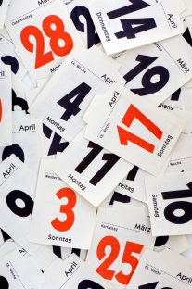
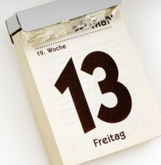
Frequency of Use
Weekly?
Daily
All the time?
Notes:
A group doesn’t just have to be a demographic group. It could be based around similar attitudes, level of engagement, behaviour etc…
ASK students to stop and write these different things on their post its.
14

Slide 15
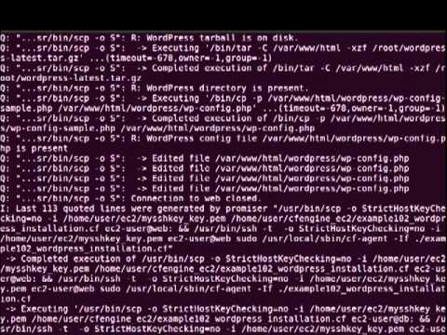
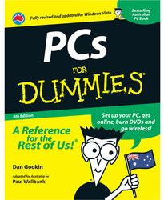

Capability
Computer and IT experience
Novice
Expert
Notes:
A group doesn’t just have to be a demographic group. It could be based around similar attitudes, level of engagement, behaviour etc…
15

Slide 16
Types of Persona
Primary persona (The one person we are designing for )
A persona whose needs must be satisfied
Multiple primary personas require separate interfaces
Secondary, tertiary, etc. personas
Personas whose needs should be considered after those of the primary persona(s)
A persona is made secondary because their needs can be mostly met if the design is focused on the primary persona

Slide 17
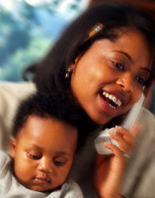

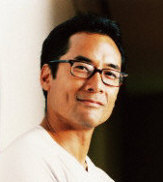

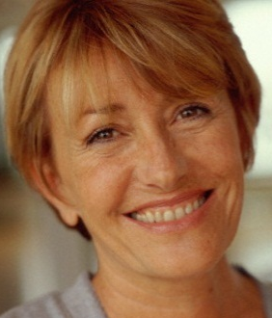



secondary
primary
special
Notes:
Your primary persona needs to be a common user type that is both important to the
business success of the product and is needy from a design point of view. This is usually a
beginning user or a technologically challenged one.
Your secondary users need to be very different from the primary users. Secondary users
may be power users or serious novices who are less valuable from a business standpoint
but cost a lot in customer support. (Business is not just about profi ts; it’s also about
savings.)
There’s a third kind of user, the user who has radically different needs for the system,
who may even need a specialized design of her own. We call these users “complementary,”
because they show us a different side of the product, a side we might not have
seen otherwise.

Slide 18
secondary
primary
special
Notes:
Evaluate. Do you have the right ones? You may choose to give up persona faves in favor of business success.

Slide 19
Names Matter
Think of your persona as a brand
People are more likely to remember a memorable name e.g.
Make names memorable, but believable!
Notes:
Comedy names, such as ‘Miguel the Mexican’ are best avoided, as are celebrity names, such as ‘Jo Lo’ or ‘Madonna’

Slide 20

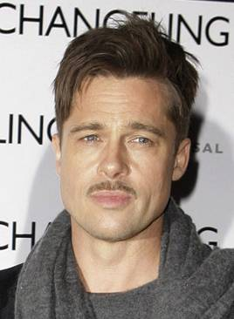
Photos of real people
Toby
The Cambridge new comer
About Toby (28)
Currently lives in Cambridge
Moved to Cambridge from London 6 months ago
Is an English & drama teacher at a Cambridge high school
Is keen on making some new friends in Cambridge
Uses the Internet most days and will use email and Facebook to keep in touch with friends
“I use the Internet for everything”
Key goals & needs
To know where places are
To find out what is going on locally
To make new fiends
From An introduction to personas for technical authors by Neil Turner http://www.slideshare.net/neiljamesturner/an-introduction-to-personas-for-technical-authors
Notes:
20

Slide 21
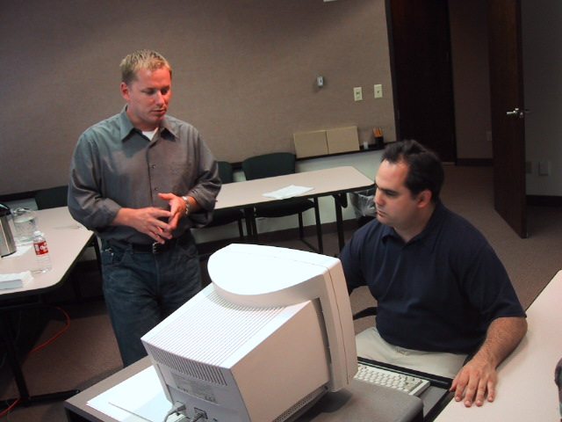
Keep Alive
I’m worried about Sandy. Can she use the profile?
Notes:
If you’re designing a computer system to be used in schools, don’t base your personas on characters from 90210!

Slide 22
Omit needless words
Only include information that is important when it comes to designing for that person
Throw away any superfluous information (unless of course it impacts the design) e.g.
Their favourite film
What car they drive
Who their best friend is
Notes:
The last example is from a company that used to send their personas birthday cards and would receive holiday postcards from their personas. It’s all about getting people regularly thinking about their users.
22

Slide 23
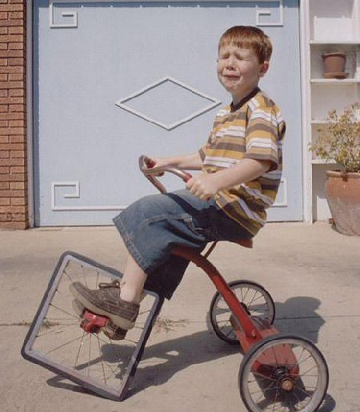
Don’t reinvent for every project
Notes:
23

Slide 24
Personas for A Fitness App: Fitness Pal
Suppose during our research we found out 3 – 4 different clusters of people

Slide 25

Sidra Yousaf
Age: 28
Single/Works in a Bank
Background: Sidra lives with her parents and two brothers. She works in a bank as a cashier which means long hours of sitting. She belongs to a low income family and she contributes to the education of her two younger brothers.
Technical Proficiency: Sidra is comfortable with the use of technology. She is active on social media and loves to shop online.
She did not grow up with money so she would not be willing to pay for an app even if it is a small amount. She has a busy routine during the day but has free time in the evening. She never had a problem with her weight but since she started her job she has started to gain weight. She is concerned about it and would like to make an effort to reach her ideal weight.
Sidra tends to follow what ever fad diets her friends suggest without doing her own research. An app that can easily guide her about her nutrition and provide her with a routine for exercise would be attractive for her.
Persona

Slide 26

Imran Sadiq
Age: 63
Married/Retired Accountant
Background: Imran is married with two grown sons. He used to work in a multinational company
Technical Proficiency: Imran likes to do things his way. He is reluctant to try new things. He has a smart phone but mostly he uses it for Calling. He has installed WhatsApp on the insistence of his kids but he does not use it frequently. His technical skills are basic.
Imran had lead a busy life but now after retirement he is finding it difficult to be productive. He has recently been diagnosed with heart disease and diabetes due to which he is concerned about his health. He has never taken much interest in fitness and he finds it hard to stick to a fitness routine. His sons are concerned about his health.
If Fitness pal is able motivate him by setting goals for him and showing him his progress , he might be interested. He hates filling out long forms and too many steps. Anything quick and simple might convince him to use the app.
Persona

Slide 27
Scenarios

Slide 28
What Are Scenarios?
Scenarios use the power of story telling to help us understand what features we need.
We imagine out Persona using the system
We write multiple scenarios for each Persona

Slide 29
Pick a persona
What is that’s personas GOAL for using your product?
Tell their story.
The most perfect, magical story of them using your software and everything is good.
All of life’s hurdles are overcome with your product.
No buttons, no errors. No design yet.
A software that works.
Notes:
Open with an exercise, ~15 minutes for quiet individual scenario writing, then 15 to exchange them. Instructions for exchanging– keep each other honest, piont out where you are thinking too much about current constraints like paywalls, or design decisions like buttons and links. Focus on the experience.
Meeting of Drama Society October 1973, Glucksman Library NO COPYRIGHT RESTRICTIONS

Slide 30
How to Write Scenarios
Set the scene.
Where are they? What is the situation?
Establish the goal or conflict.
What worries them? What is the dream?
Overcome crises along the way.
What are the kind of hurdles on usually run into?
Achieve resolution.
How will your software save the day?
Reach denouement.
Then what? How do they leave?
Notes:
Revisit your scenarios with this. Add in details. ~10-15 minutes.
“Your mission is to document that experience from the persona’s point of view. I like to use the classic components of good storytelling when doing this.
Set the scene.
Where is the persona when he or she first discovers the need that will lead him or her to the Web site? When does it happen? Who else is around possibly influencing his or her decision? What else is going on at the time? Be as specific as possible to create a realistic story, just as you were with the persona details.
Establish the goal or conflict.
Visits to the site are triggered by goals, so something must have happened to prompt your persona to go to your site. What was it? Perhaps it occurred in typical narrative fashion, based on a conflict with someone else or an inner conflict that he or she needed to resolve. Be very clear about what your persona is trying to achieve by visiting the site, keeping in mind that he or she could have multiple goals.
Overcome crises along the way.
When the persona comes to the site, how does he or she enter? What decisions does he or she make along the way? How does the persona find what he or she’s looking for? Are there intermediate steps to describe? What challenges does the persona face along the way that the site helps with? Does the action all take place on your site, or does the persona use other sites, email, IM, phone calls, meetings with others, store visits, and so on? Even though this is an idealized story about how your site could satisfy this persona’s needs perfectly, be realistic about what he or she would actually do. How does the persona feel about the experience while going through it?
Achieve resolution.
How does the persona ultimately achieve his or her goal? What are the persona’s attitudes at the climax of his or her story? What are the most critical factors in helping the persona achieve his or her goal?
Reach denouement.
What does the persona do after succeeding? How does the persona leave the site? How does this story affect his or her work or life? What’s his or her perception afterward? How does the persona’s success impact your business?

Slide 31
Imran Sadiq woke up at his usual time. He picked up his phone to check the time and saw their was a notification from his Fitness Pal. He had installed Fitness Pal on his phone with the help of his son last night. He opened the notification and it had 3 options for his breakfast that would help him achieve his goal. He liked having options. He tapped on option 3 as it suggested boiled egg and tea. He liked how the app had stored his preferences and suggested according to that.
After breakfast he got busy reading his paper, the app reminded him to take his medication. His wife was surprised that he was able to remember it because she usually has to remind him. After breakfast he went for a walk around his neighborhood. After his walk he checked his Fitness Pal to check how many steps he had taken. He was happy to see his progress. The app suggested he challenge his fitness budy (his oldest son) to a fitness challenge for the day. He liked the idea. With one click he sent his son notification challenging him to see who burns the most calories till ten oclock at night.
He was motivated to stay active the whole day and even though he lost to his son today but he was determined to beat him tomorrow. He was happy that he finally was taking care of his health while enjoying the process.
Scenerio

Slide 32
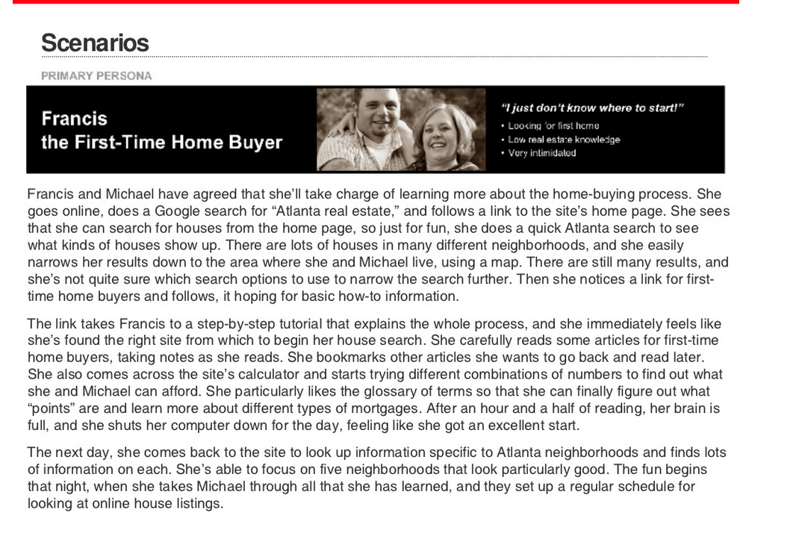
From Steve Mulder’s The User is Always right http://www.slideshare.net/MulderMedia/the-user-is-always-right-making-personas-work-for-your-site
Notes:
Not everyone has the “no design” philosophy (as you can see) but it helps in this world of many different kinds of solutions.

Slide 33
Adjust for frequency

Slide 34
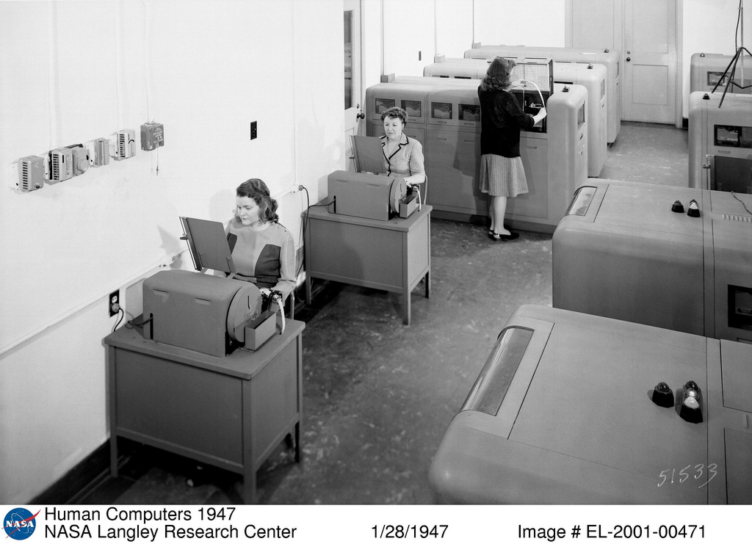
Daily-Use Scenarios
Daily Use
Usually only 2-3 of these
Clear training, quickly removed
Shortcuts & power tools
Customization
Tell the story of the 300th use as well as the 1st
NOT ALL APPS HAVE DAILY USE

Slide 35
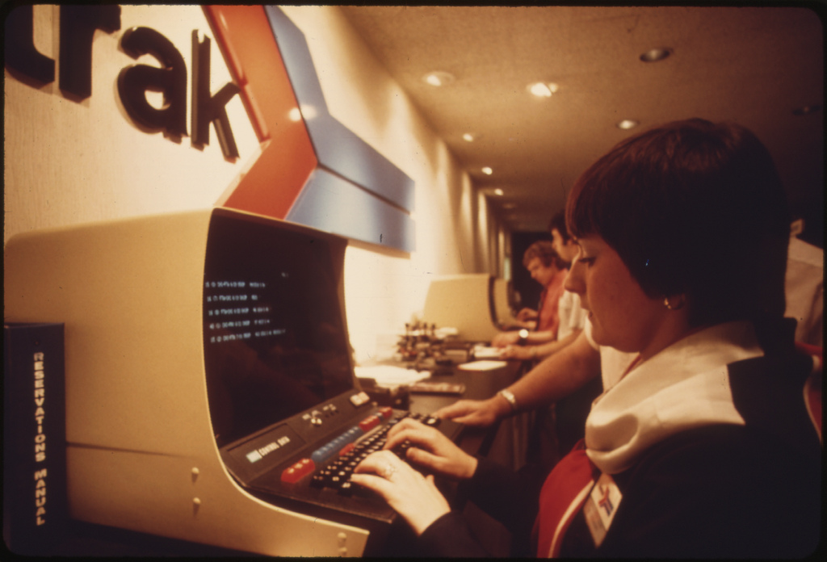
Infrequent, Common Scenarios
Infrequent, Common Scenarios
Users do it only once in a while
Many users do it – core to business
Expected to “just work”
Users unlikely to pay close attention
Needs excellent unobtrusive help
Will be taught each use
Notes:
Users looking up a train schedule or tickets at amtrak… they don’t expect to have to deal with a tutorial, they just want in and out

Slide 36
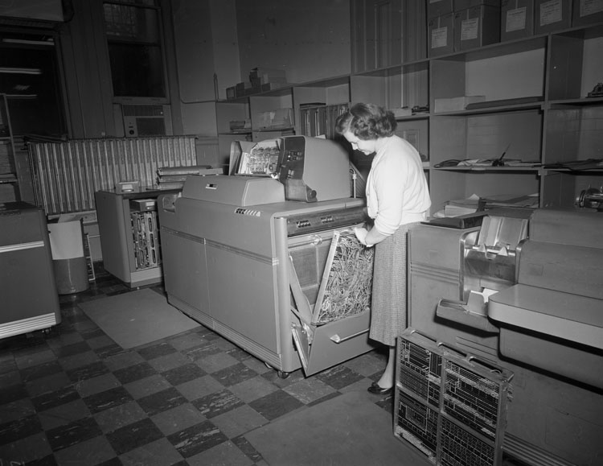
Necessary-Use Scenarios
Must be done, but aren’t done often
User needs to get right, be comfortable it works
Changing printer cartridges, clearing memory, fighting a virus, visiting a potentially infected website, deleting a lot of files
Must have good help
Must have excellent error handling
No need for customization or shortcuts

Slide 37
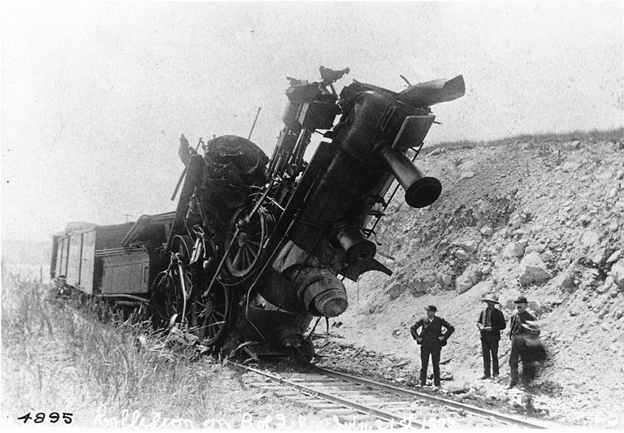
Edge-Case Scenario
Unusual situations
Programmers must handle, or code will not work
Design can largely ignore beyond quick fixes.
Work on last (or not at all)

Slide 38
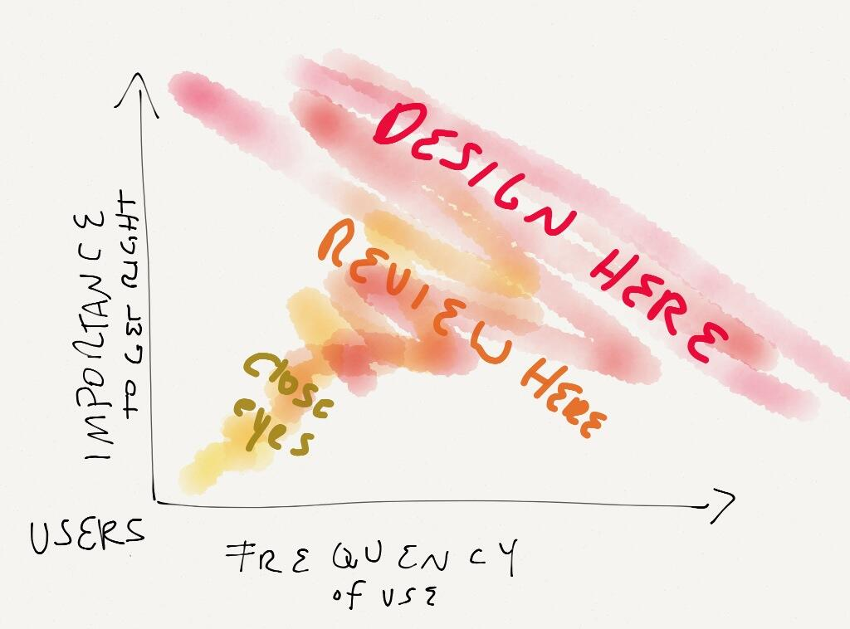

Slide 39
Three types of scenarios
context scenario
key path scenario
validation scenarios

Slide 40
Context Scenarios
is used to explore, at a high level, how the product can best serve the needs of the personas.
They are written from the persona’s perspective, focusing on human activities, perceptions, and desires.
It is when developing this kind of scenario that the designer has the most leverage to imagine an ideal user experience

Slide 41
Context Scenario -Example
Lisa is in lecture and realizes she’s confused when the instructor starts talking about mitosis. She takes note of the time. – Later that day she opens up her bSpace course site and goes directly to the webcast for that day and reviews the portions of lecture via the webcast she needed clarification on.

Slide 42
Key Path Scenarios
Once the design team has defined the product’s functional and data elements and developed a Design Framework, a context scenario is revised.
It becomes a key path scenario by more specifically describing user interactions with the product and by introducing the design’s vocabulary.
These scenarios focus on the most significant user interactions, always paying attention to how a persona uses the product to achieve its goals.
Key path scenarios are iteratively refined along with the design as more and more detail is developed.

Slide 43
Key Path Scenario Example
Lisa is in lecture and realizes she’s confused when the instructor starts talking about mitosis.
She takes note of the time. – Later that day she opens up her bSpace course site clicks on the “Most Recent Webcast” link. bSpace switches to the “Use Webcast” View and the webcast for the day plays.
Lisa looks at her notes to see the time she noted earlier, and enters it into the “Lecture Time” field and presses “Enter.”
The lecture jumps forward to the point where the instructor was talking about mitosis.

Slide 44
Validation Scenarios
To test the design solution in a variety of situations.
These scenarios tend to be less detailed and typically take the form of a number of what-if questions about the proposed solutions.

Slide 45
Initially while writing context scenario don’t worry about exactly how things would be done .
Focus on the What instead of How

Slide 46
Exercise 1
Users of an airline site:
parents with two small boys, single woman business traveler, grandma going to visit grand kids
Users of IRS site:
18 year old filing first tax return, new small business owner, someone who has just retired
User of job-search site
22 year old college grad, new immigrant from Guatamala, 45 year old project manager

Slide 47
References
http://theuxreview.co.uk/personas-the-beginners-guide/
Book: The inmates are running the Asylm by Alan cooper
HCI by Dix et al
http://webdesign.tutsplus.com/articles/defining-and-applying-personas-to-ux-design--webdesign-7561
http://www.smashingmagazine.com/2013/07/04/top-ten-app-part-1-idea-and-design/
https://www.youtube.com/watch?v=DvV7ZcRVQ4g

